Slide 1




TRAFFIC SIGNBOARD INSTRUCTOR

Slide 2



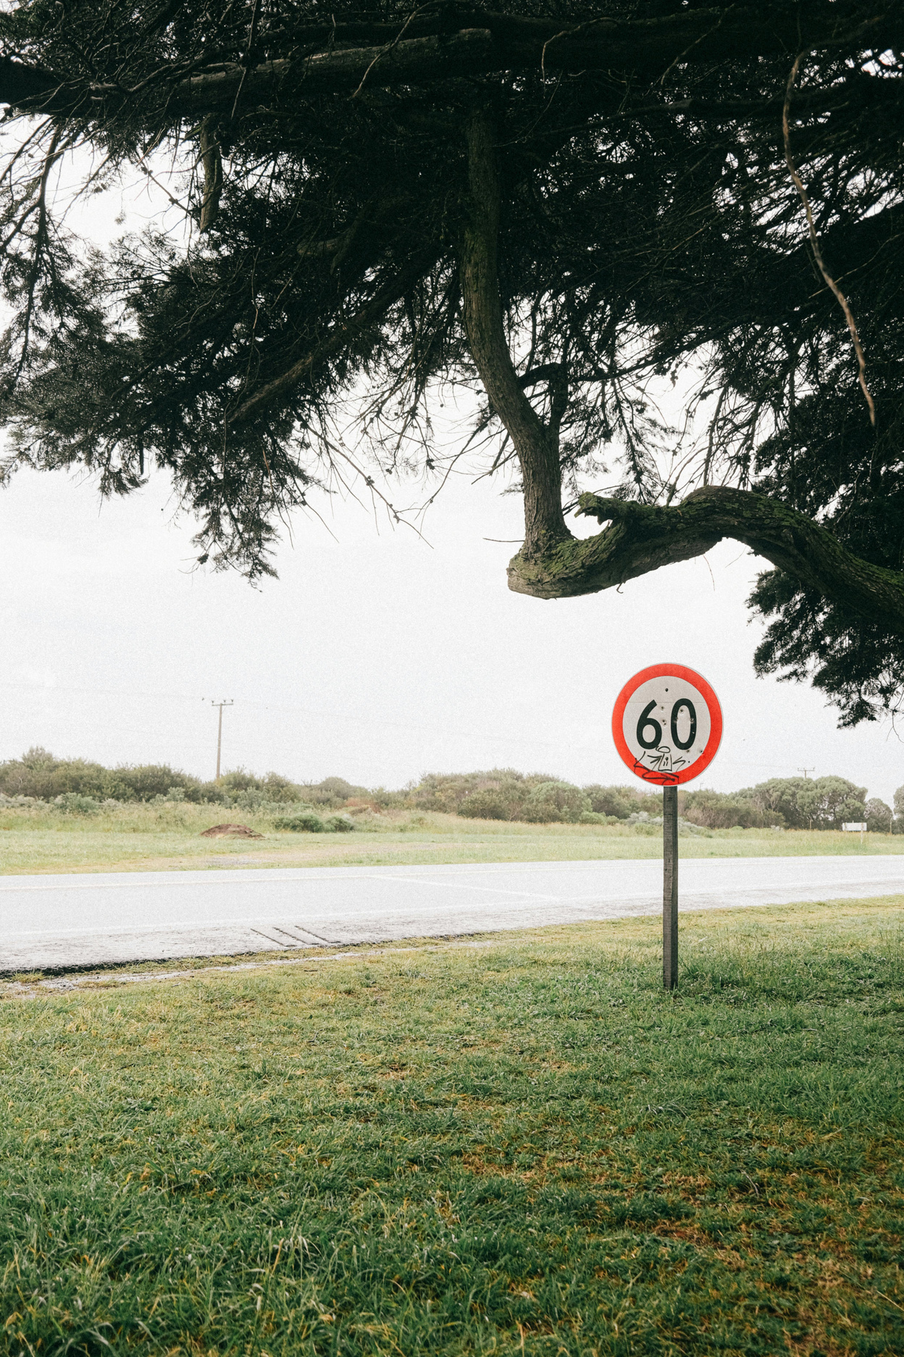
INTRODUCTION
The Traffic Signboard Instructor is an advanced application designed to recognize and classify traffic signs from uploaded images.
This project aims to develop a Traffic Sign Recognition System using Machine Learning for recognizing and classifying traffic signs from images, providing users with detailed information through an intuitive, user-friendly interface.
The solution is designed to assist drivers in understanding traffic signals, enhancing road safety and awareness.

Slide 3
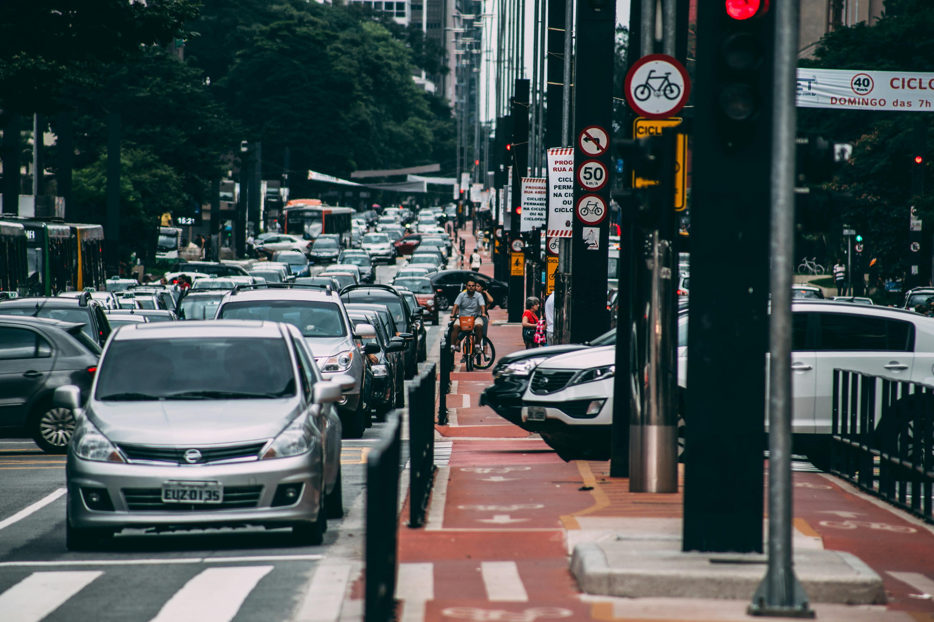
PROJECT OVERVIEW
Create a new user account to access the application.
Login with your username and password
Manage users and view system statistics through admin dashboard.
Django interface for image upload and prediction.
Upload an image of a traffic sign and predict its meaning using CNN.

Slide 4


MILESTONE
1
The system allows users to register, log in, and verify email addresses, with password reset functionality and security measures to protect user data.
3
Develop a Django-based interface for image upload and processing, display recognized traffic sign information, and deploy the application on Hugging Face Spaces.
2
Implement traffic sign recognition using CNN and Keras, with data preprocessing and augmentation. Deploy it to Hugging Face Model Hub.
4
The final working system is tested and deployed for users to interact with, uploading images and receiving traffic sign predictions.

Slide 5


TECHNOLOGIES USED
Deep learning
Django
Django is a Python framework that makes it easier to create web sites using Python.
Used CNN for accurate prediction of traffic signs from uploaded images.

Slide 6
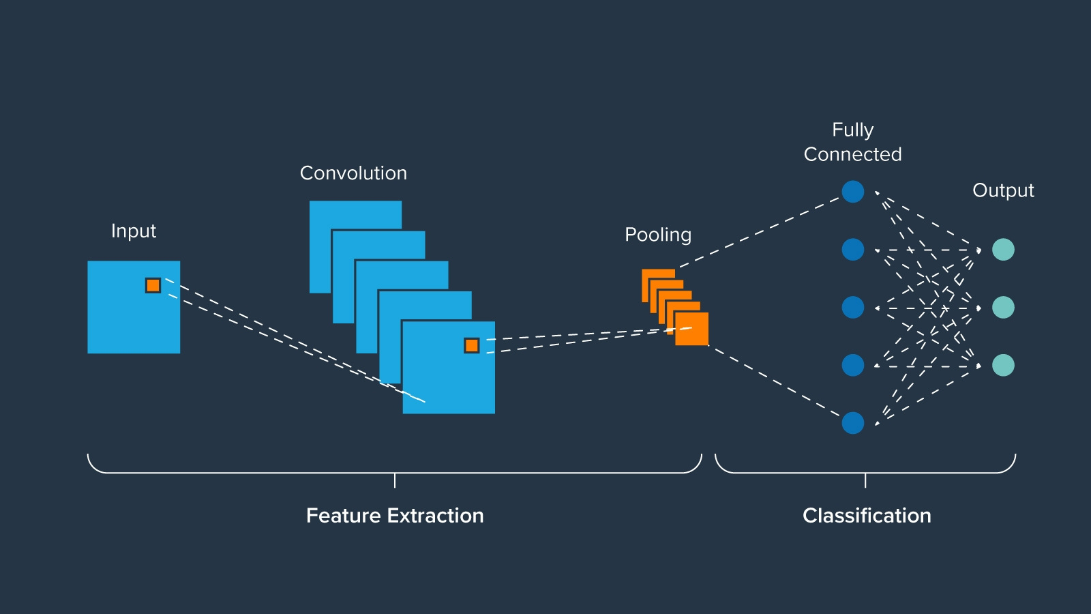
CNN MODEL

Slide 7
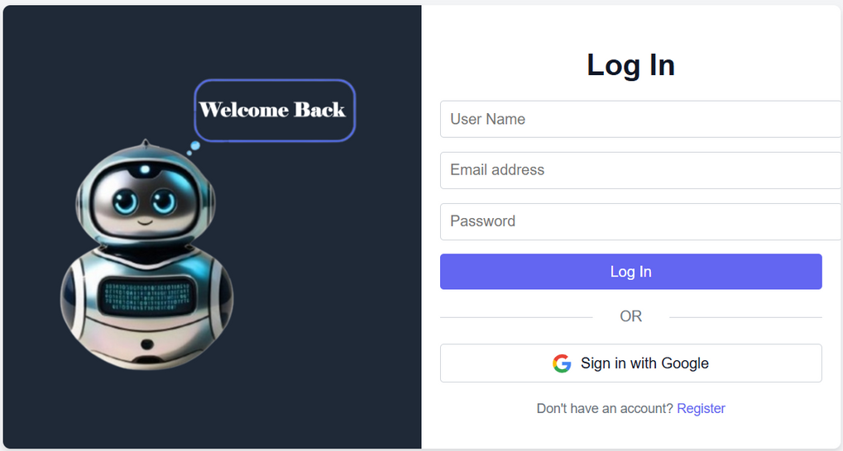
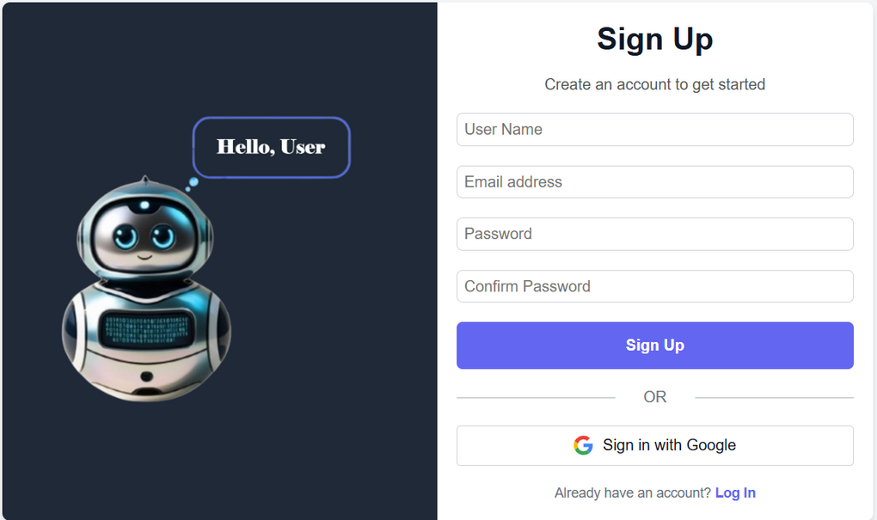
LOGIN/REGISTER

Slide 8
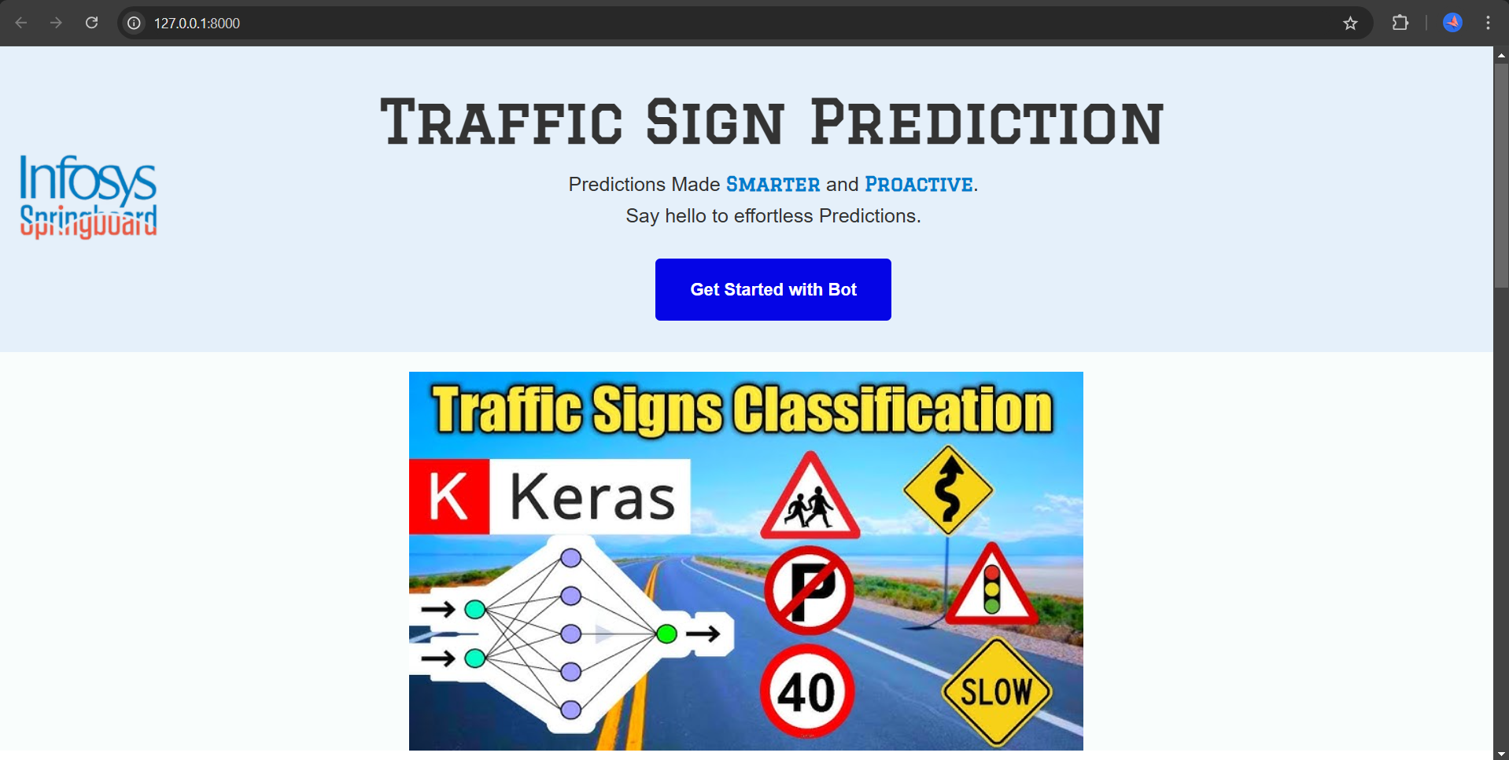
LANDING PAGE

Slide 9
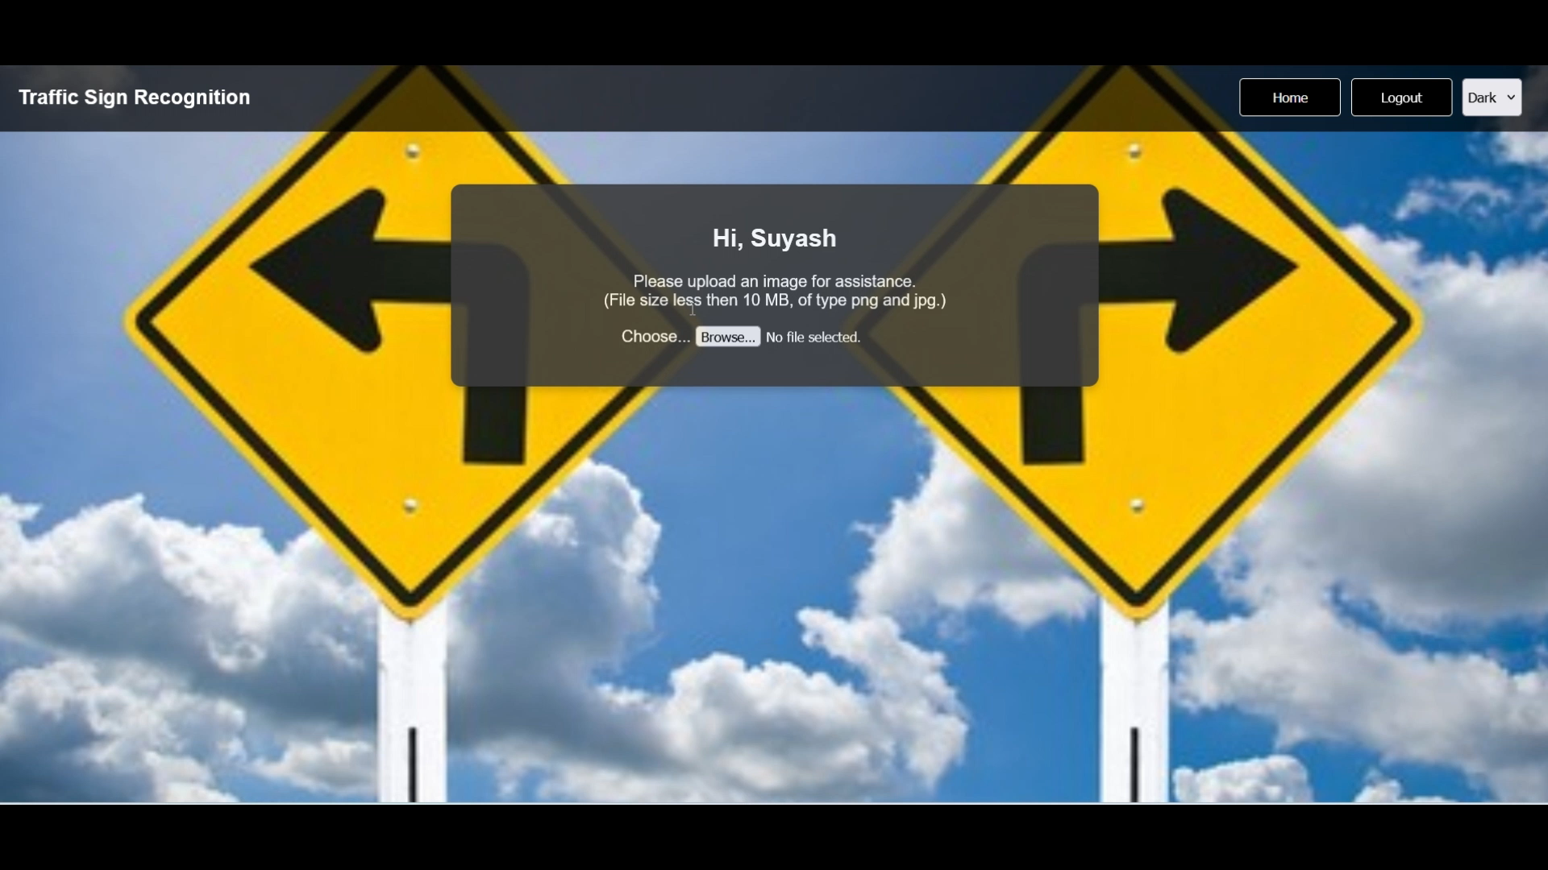
HOME PAGE

Slide 10
FUTURE ENHANCEMENTS
expanding the dataset for better accuracy, optimized performance
integrating multilingual support
providing detailed educational insights about traffic signs to further enhance the user experience.

Slide 11
CONCLUSION
In conclusion, the Traffic Signboard Instructor project successfully combines web development and machine learning to create a functional and user-friendly application. Using the Django framework, we developed a secure platform for user authentication, image uploads, and the display of traffic sign information.
A CNN model trained on a comprehensive traffic sign dataset was integrated to ensure accurate predictions.
Our objective was to provide an educational and informative tool for users to learn about traffic signs through image recognition, with a user-friendly interface and secure access control.

Slide 12

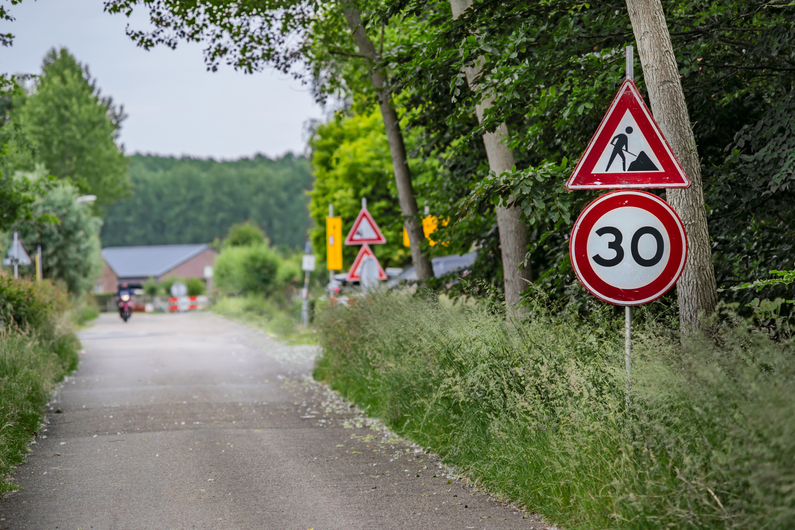
TEAM ALPHA
TEAM MEMBERS
Suyash
Charan
Asutosh
Vaidehi
Charitasri
Rohan

Slide 13

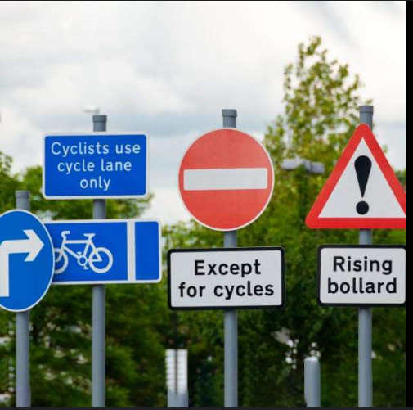
THANK YOU!

